Slide 1
IoT Inertial Mesuament Unit Monitoring
Tanawin Siriwan 6203014610060 sec 1
College of industrial technology
Mechatronics Engineering Technology Division
Asst. prof. Dr.Supod Keawkorn

Slide 2
Topic
Introduction
Object
Scope
Process
Priciple
Test
Problem
Summarize

Slide 3
Objective
For stutdy how to application VCL/FMX using delphi.
For stutdy how to use delphi connect the controller using TCP/IP.
For design IMU data monitoring system

Slide 4
Scope
Data monitoring
Transive and resiceve data using TCP/IP
Control 3D opject movment
Loggging data file
Sorted Data in MySQL database
Send data to MQTT
Monitoring on Nod-Red

Slide 5

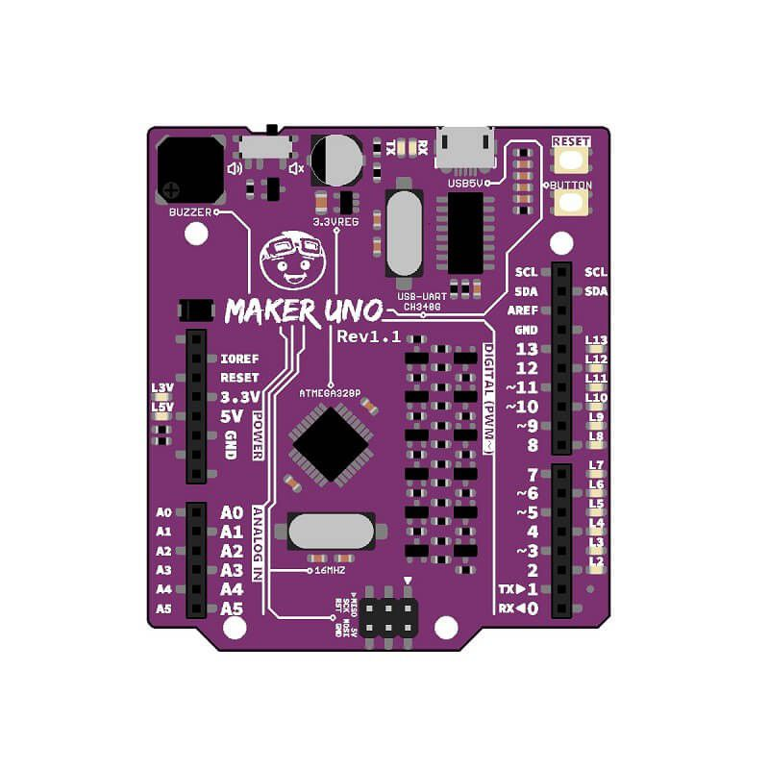
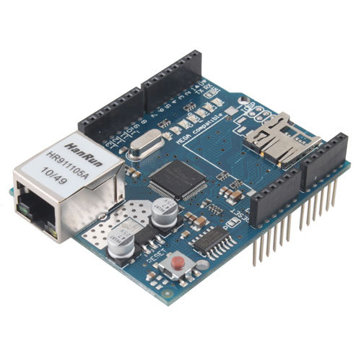
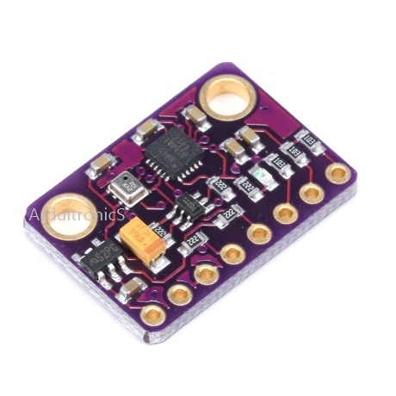





IoT Inertial Mesuament Unit Monitoring
TCP/IP

Slide 6
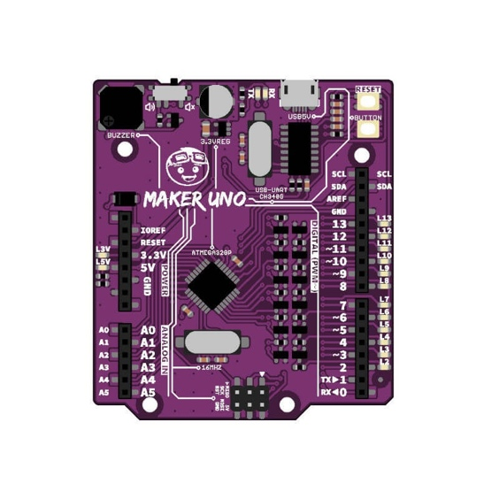
Arduino
SMD ATmega328P microcontroller. USB Programming facilitated by the CH340. Input voltage: USB 5V, from computer, power bank or standard USB adapter. 500mA (maximum) 3.3V voltage regulator. 0-5V outputs with 3.3V compatible inputs. 14 Digital I/O Pins (6 PWM outputs). 6 Analog Inputs. ISP 6-pin Header. 32k Flash Memory. 16MHz Clock Speed. R3 Shield Compatible. LED array for 5V, 3.3V, TX, RX and all digital pins. On board programmable push button (pin 2, need to configure as INPUT_PULLUP). On board piezo buzzer (pin 8). Utilize USB Micro-B socket.

Slide 7
Arduino Ethernetsheild
Shield | Name | Arduino® Ethernet Shield Rev 2
 | SKU | A000024
 | Compatibility | UNO, MEGA
Ethernet | Connector | RJ45
 | Controller | W5500
 | Speed | 10/100 Mbps
 | Communication | SPI
 | Internal memory | 32KB
 | Maximum sockets | 8 individual
 | Supported protocols | IPv4, ICMP, TCP, UDP, ARP, IGMP, PPPoE, MQTT
Storage | Micro SD card slot
Power | Operating voltage | 5V
Connectors | TinkerKit | Yes, 6x

Slide 8
GY-91
MPU9250 + BMP280 module (Three-axis gyroscope + triaxial accelerometer + triaxial magnetic field + pressure) Module Model: GY-91 Use chip: MPU-9250 + BMP280 Power supply: 3-5v (internal low dropout regulator) Communication: standard IIC / SPI communications protocol -Chip 16bit AD converter, 16-bit data output Gyroscopes range: ± 250 500 1000 2000 ° / s Acceleration range: ± 2 ± 4 ± 8 ± 16g Field range: ± 4800uT Pressure range: 300-1100hPa

Slide 9
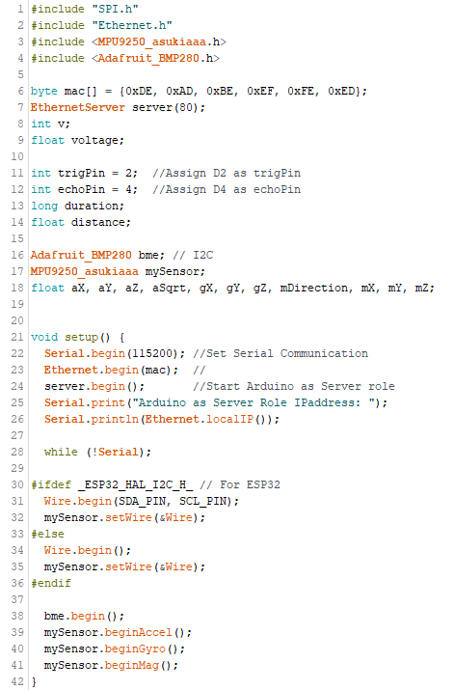
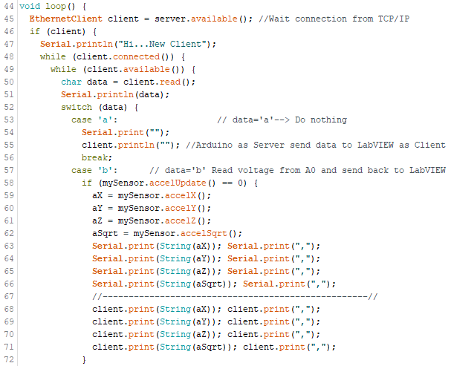
Arduino I2C Connected IMU

Slide 10
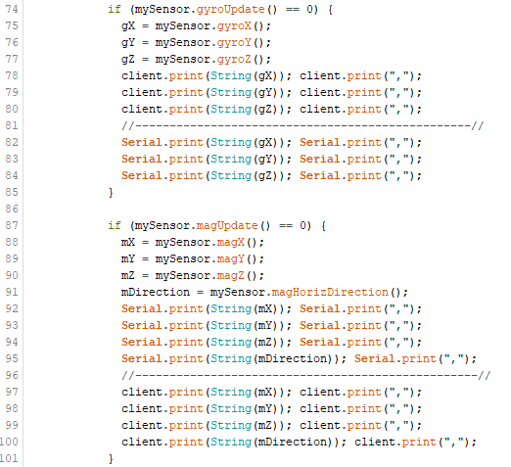
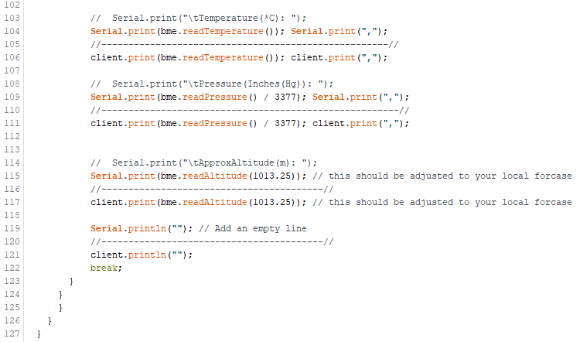
Arduino I2C Connected IMU

Slide 11
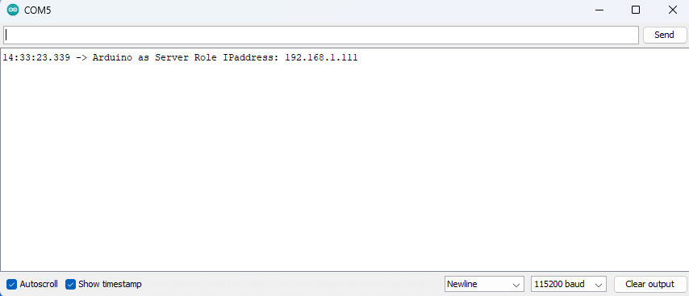
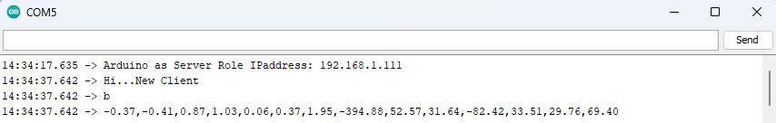
Arduino I2C Connected IMU
Arduino IP
Delphi Connected

Slide 12
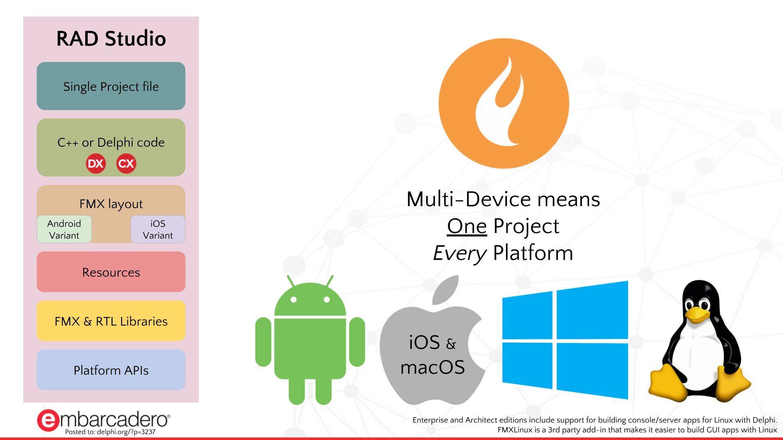
Imprementation On FMX Application

Slide 13

Delphi Conect Arduino Using TCP/IP
Server
Client
TCP/IP

Slide 14
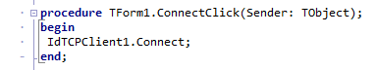
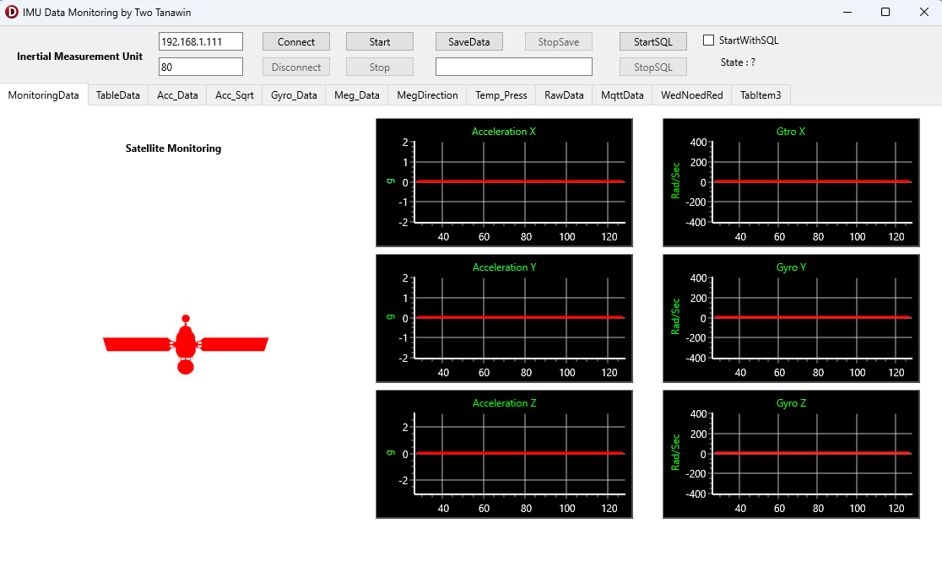
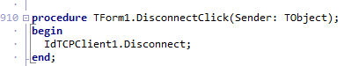

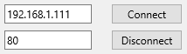
Delphi TCP/IP Connected Controller

Slide 15
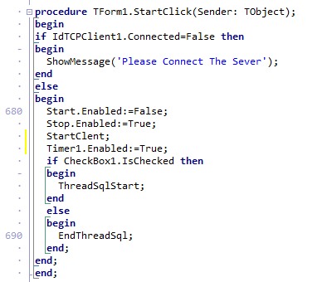
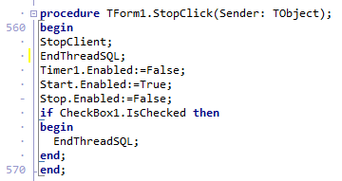
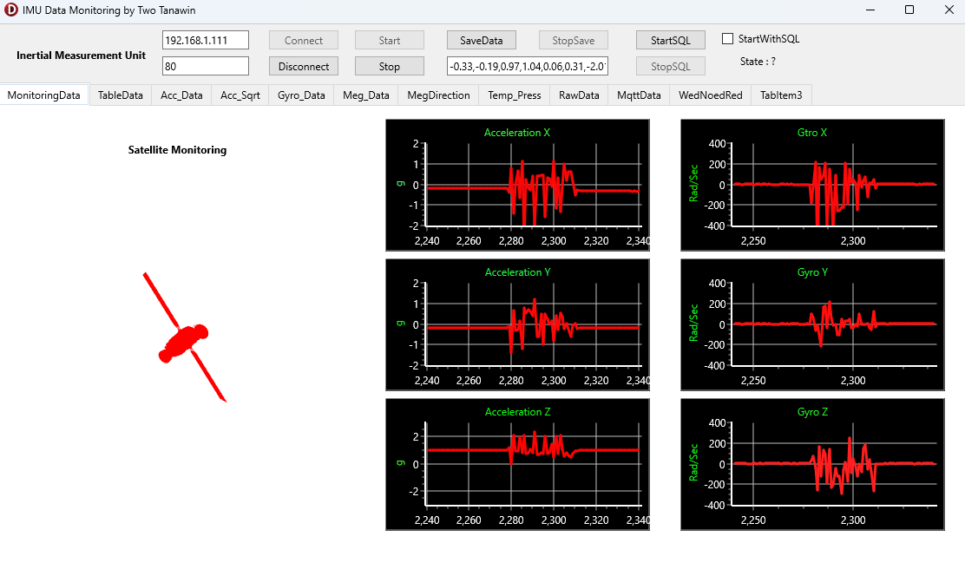
Delphi Start System
Click

Slide 16
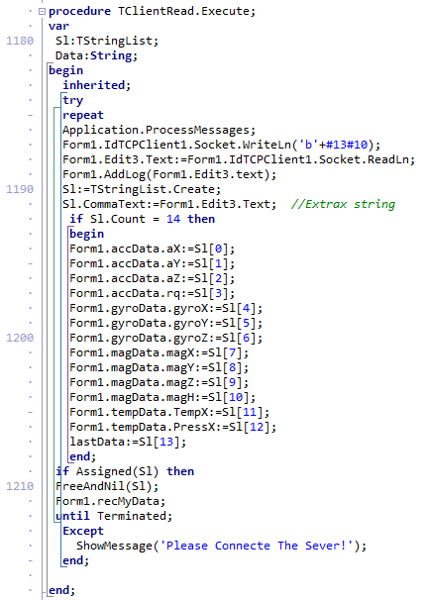
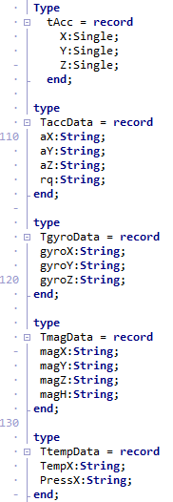
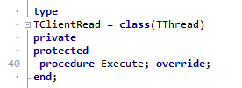
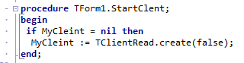
Delphi Extrax Data

Slide 17
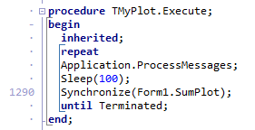
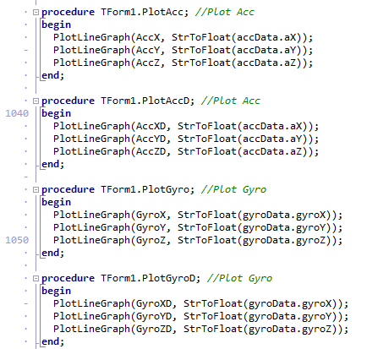
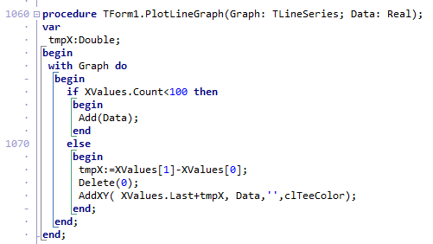
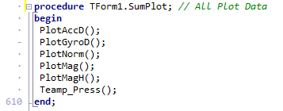
Delphi Plot Graph

Slide 18
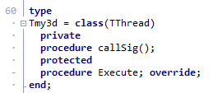
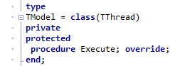
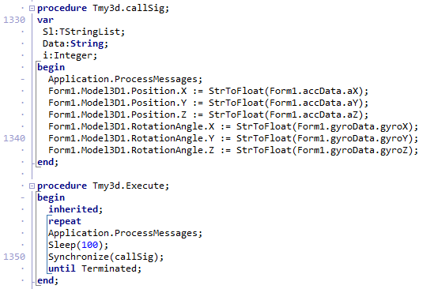
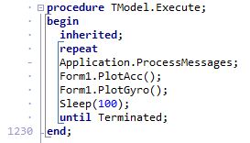
Graph In FMX Application

Slide 19
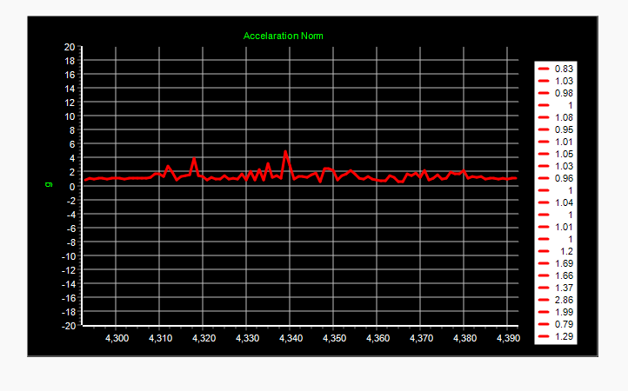
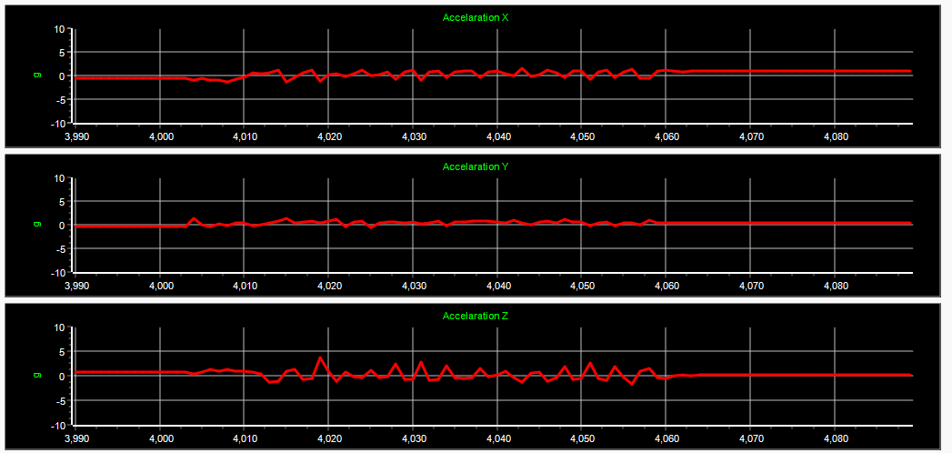
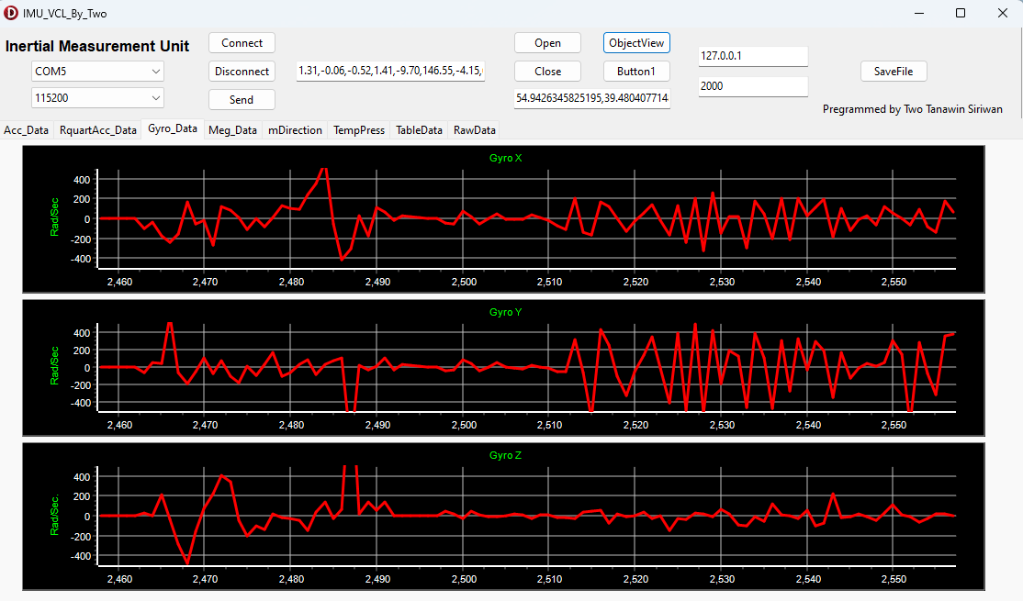
Graph In FMX Application
Acceleration XYZ
Acceleration Norm
Gyro XYZ

Slide 20
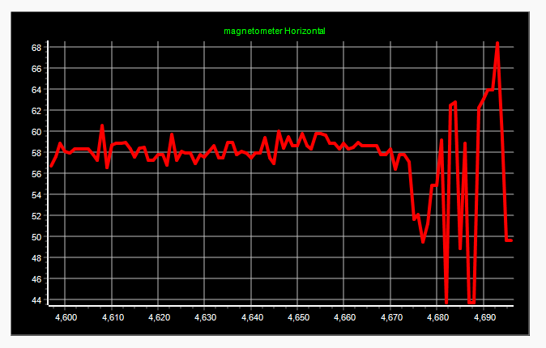
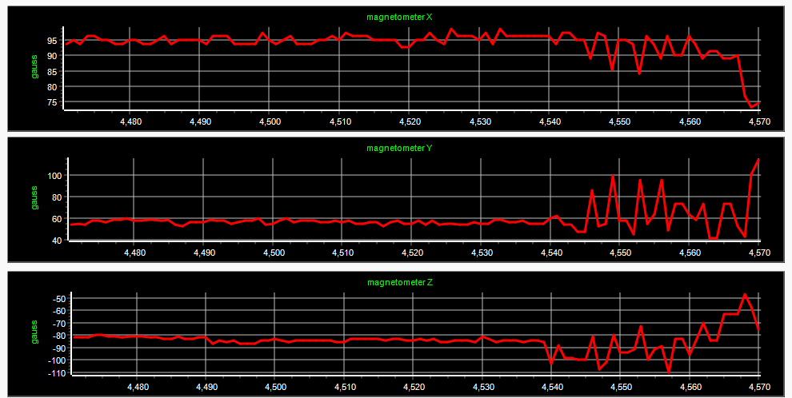
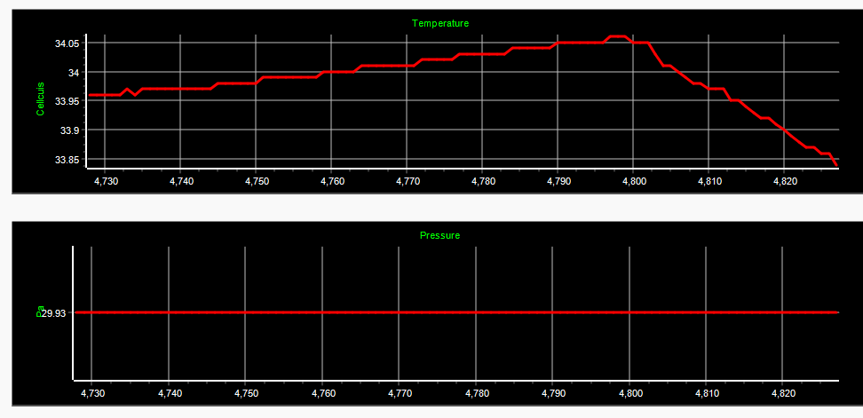
Graph In FMX Application
Magnetrometer Horizontal
Magnetrometer XYZ
Temp & Pressure

Slide 21
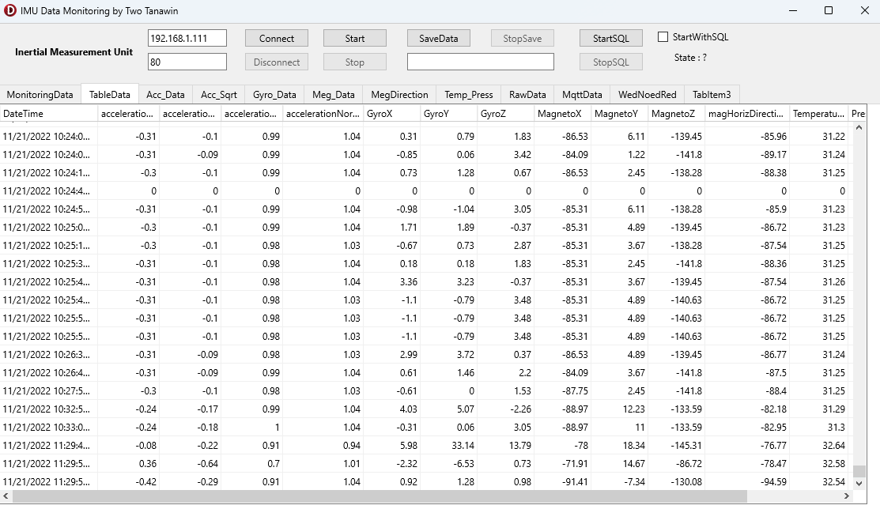
Delphi Store Data Using MySQL

Slide 22
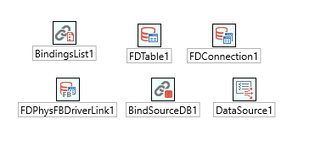
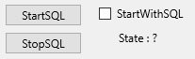
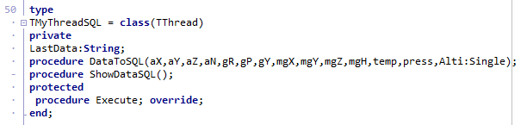
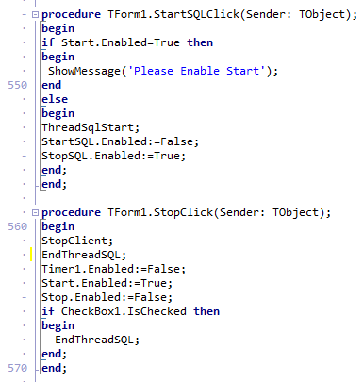
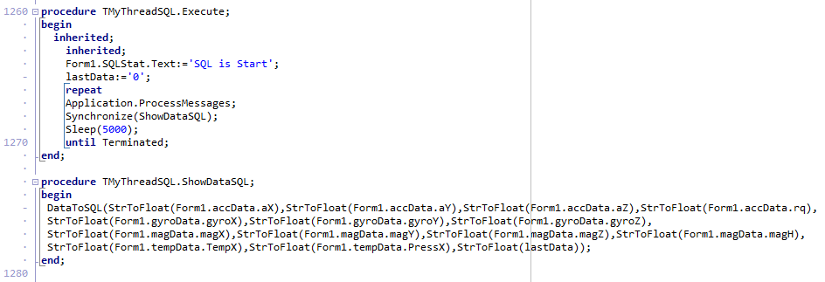
Delphi Record Data Using MySQL

Slide 23
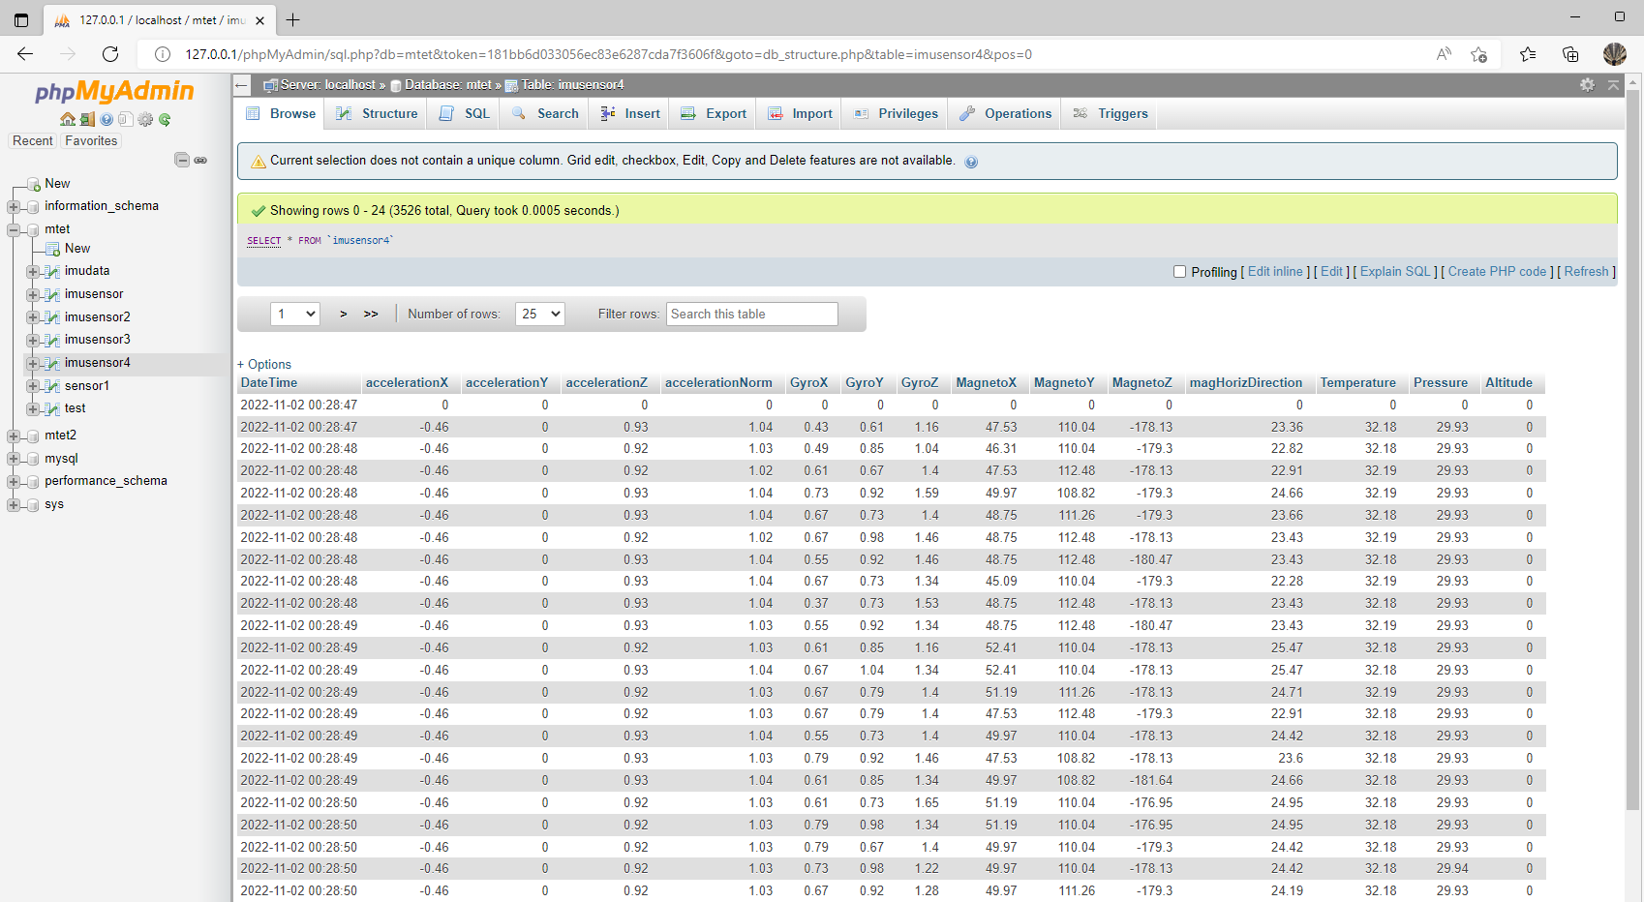
MySQL Database Result

Slide 24
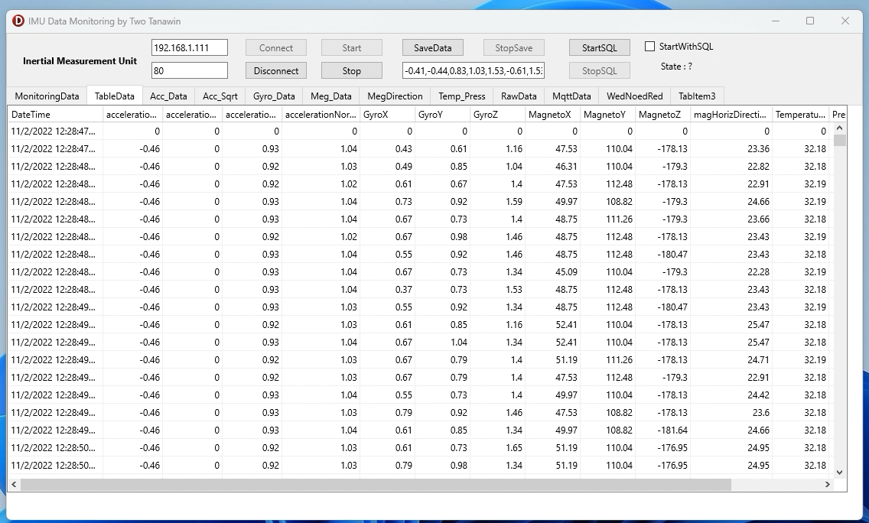
MySQL Database Result

Slide 25
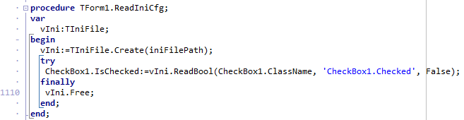
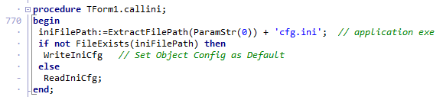
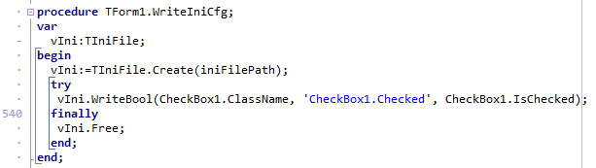
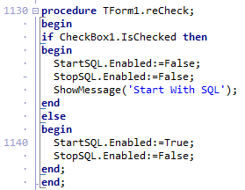
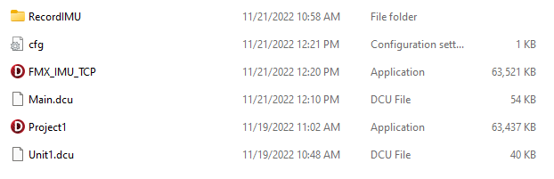
Delphi ini File

Slide 26
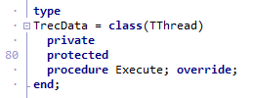





Delphi Data Logging

Slide 27

Delphi Data Logging

Slide 28


Delphi Data Logging

Slide 29
Datavisualization Using Node-RED
Publicer
Broker
Subscriber

Slide 30





Delphi Conect MQTT

Slide 31



Delphi Connect MQTT

Slide 32

Delphi Connect MQTT
Subscriber
Publicer

Slide 33

Delphi Connect MQTT

Slide 34


Form Creat & Close

Slide 35

Hive MQTT

Slide 36


Node-Red Extrax Data

Slide 37

Datavisualization Using Node-RED

Slide 38

Datavisualization Using Node-RED

Slide 39

IoT Inertial Mesuament Unit Monitoring

Slide 40

Problem

Slide 41


Applied
Delploy Other Device
Monitoring Real Machine

Slide 42
THE END THX

